Slide 1
URBANIC CLONE

Slide 2
TABLE OF CONTENT
INTRODUCTION
EXISTING SYSTEM
OBJECTIVE
SYSTEM REQUIREMENT
TECHNOLOGY
MODULES
SNAPSHOT
FUTURE SCOPE

Slide 3
INTRODUCTION
The Urbanic clone is a web-based e-commerce platform that provides a turnkey solution for businesses and entrepreneurs looking to start their own online store. This clone replicates the functionality and user experience of the popular Urbanic e-commerce platform, which is known for its user-friendly interface and modern design.
With the Urbanic clone, businesses can create their own online store without the need for extensive technical knowledge or resources. The clone includes a range of features such as product listings, shopping cart management, payment processing, and order tracking, making it easy for businesses to manage their e-commerce operations.

Slide 4
EXISTING SYSTEM
Urbanic e-commerce platform is a popular and powerful tool for businesses looking to create and manage their own online stores, there are several problems with the system that need to be addressed. These problems include:
Cost: One of the main problems with the Urbanic platform is its cost. While it offers a comprehensive set of features, the platform can be expensive for small businesses and entrepreneurs to use, particularly those who are just starting out.
Integration: While the Urbanic platform integrates with a range of payment gateways and shipping providers, businesses may find it challenging to integrate with other third-party systems and services.
Security: The Urbanic ay need to implement additional security measures to ensure the safety and security o

Slide 5
OBJECTIVE
Developing a user-friendly interface that is easy to navigate and use for both businesses and customers.
Providing affordable pricing options for businesses of all sizes, including small startups and entrepreneurs.
Utilizing Integrating with a range of third-party systems and services to streamline business operations and increase efficiency.
Implementing advanced security measures to protect sensitive user and payment information.
Providing comprehensive customer support and technical assistance to ensure that businesses can make the most of the platform's features and capabilities.

Slide 6
TECHNOLOGY
Frontend: HTML,CSS,JAVASCRIPT,BOOTSTRAP
Backend: NODE JS
Database: MONGO DB
Framework: Express JS

Slide 7
MODULES
The modules of the Urbanic clone include:
User Module: The User Module is the primary module of the Urbanic clone and is responsible for managing user accounts, including account creation, login, and account management. This module includes features such as user profiles, account settings, and order history.
Product Module: The Product Module is responsible for managing the products available for purchase on the e-commerce platform. This module includes features such as product listings, product descriptions, images, and pricing information.
Order Module: The Order Module is responsible for managing the order processing and fulfillment process. This module includes features such as shopping cart, checkout process, order confirmation, and order tracking.
Payment Module: The Payment Module is responsible for managing the payment processing system for the e-commerce platform. This module includes features such as integration with payment gateways, processing of credit card payments, and handling of refunds.

Slide 8
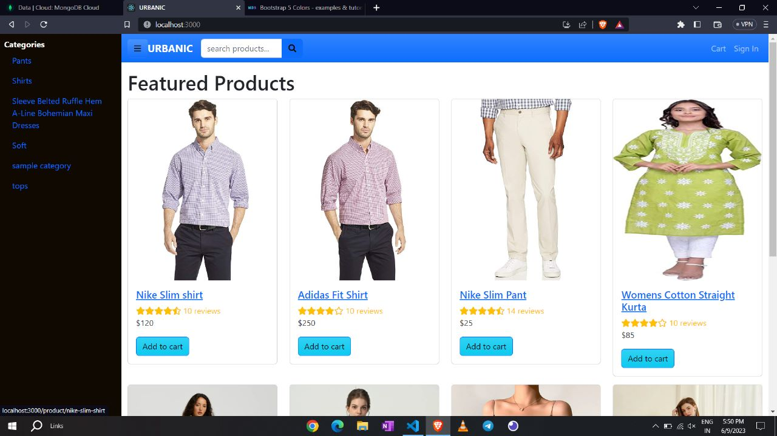
SNAPSHOT

Slide 9
FUTURE SCOPE
1. Expansion to new cities: As the project gains traction and proves its viability, expanding to new cities and regions can be a significant opportunity. Urbanic clones can be customized to suit the needs of specific urban areas, offering localized services and solutions.
2. Integration of emerging technologies: Future iterations of the Urbanic clone project can integrate emerging technologies such as artificial intelligence, machine learning, Internet of Things (IoT), and blockchain. These technologies can enhance the efficiency, scalability, and security of the platform, providing better user experiences and enabling new services.

